Slide 1

FAST MESSAGE PROPAGATION OVER IOV SCENARIOS
Dipartimento di Matematica "Tullio Levi-Civita"
Laurea in Informatica
a.a. 2018-2019
Relatore: Prof. Claudio Enrico Palazzi
Co-relatore: Dott. Armir Bujari
Jordan Gottardo 1179739
Esame di laurea - 18 Luglio 2019
1/14

Slide 2
CONTENTS

Slide 3
Intro
Contents
Context 1: IOV scenarios VANET, DANET, ESD
Context 2 / Technologies, ns-3, obstacle model forse estendere a 2 slides
Miei contributi
Algorithm 1: Fast-Broadcast
Algorithm 2: ROFF
Qualitative: buildings no buildings fb roff ecc
Lista scenari: Platoon 1D, Grid 2D, LA, Padova, LA smart city
Scenario 3D varie distanze
5 metriche
Scenario: Padova no SJ
5 metriche no buildings + buildings
Smart Junction extension
Scenario: Padova con SJ
5 metriche buildings no SJ + buildings SJ
Scenario 2: LA Smart City 2D + 3D
5 metriche no build + build + high build? Se ci stanno tutti e 3
Scenario forging attack
Conclusioni

Slide 4

CONTEXT
Vehicular and Drone Ad-Hoc Networks (VANETs and DANETs)
Several applications
Smart city management
Video streaming
Traffic control
Focus: Emergency Message Distribution (EMD)
Message delivery
Timeliness
Avoid medium saturation
5

Slide 5



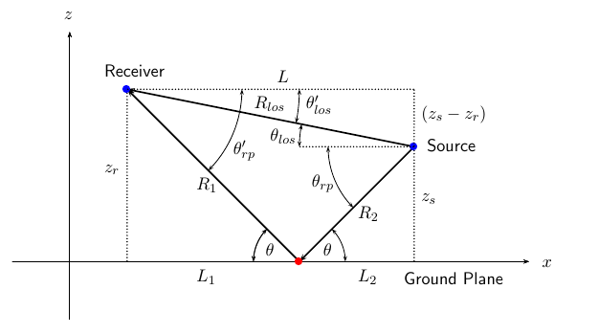
CONTEXT 2
Expensive large scale tests
Need to use simulators (ns-3)
Additional tools and models
Real map data
Road junction modeling
Signal propagation models
Two-Ray Ground
Obstacle shadowing (with 3D extension) ^{[1] [2]}
[1] C. Sommer, D. Eckhoff, R. German, and F. Dressler, “A computationally inexpensive empirical model of ieee 802.11p radio shadowing in urban environments”, 2011
[2] M. Romanelli, C. Palazzi, and A. Bujari, “Propagazione di messaggi tra veicoli con modello urbano realistico”, Master’s thesis, University of Padua, 2017.
5

Slide 6


FAST-BROADCAST
Multi-hop delay-based broadcasting protocol
Dynamic transmission range estimation
No need to know it a priori, as often assumed in other protocols
Estimation Phase:
Vehicles exchange small Hello Messages (beacons) to estimate their transmission range
Broadcast Phase:
A vehicle sends an Alert Message
The neighbors receive it and participate in contention to broadcast it
The vehicles farther from sender wait less time before broadcast
5

Slide 7
ROFF
Multi-hop delay-based broadcasting protocol
Deterministically determines the farthest forwarder
Estimation Phase:
Vehicles exchange beacons to discover their entire neighborhood
Each vehicle builds a Neighbor Table (NBT) with one entry for each neighbor
Broadcast Phase:
Vehicles differentiate their waiting times based on unique forwarding priority
Nodes farther from the previous sender have higher priority
5

Slide 8

MY CONTRIBUTIONS
Improvements to Fast-Broadcast
Implementation and extension to 2D and 3D scenarios of ROFF
Evaluation and comparison of Fast-Broadcast and ROFF through simulations
Scenarios with and without buildings
Proposal of extension to exploit road junctions to increase message delivery ratios
SJ-Fast-Broadcast and SJ-ROFF (SJ=Smart Junction)
5

Slide 9


SIMULATIONS – SCENARIOS AND METRICS
Several scenarios of increasing complexity
Metrics
Total delivery ratio
Total delivery ratio on circumference
Number of hops
Number of slots
Forwarding node number
Scenario name | Type | Buildings | Drones
Platoon | 1D
Grid | 2D
Los Angeles | 2D
Padua | 2D
Los Angeles smart city | 3D
5

Slide 10
PRELIMINARY TESTS
Scenario configuration
Scenario name | Padua
Latitude N [°] | 45.4171
Latitude S [°] | 45.3981
Longitude W [°] | 11.8654
Longitude E [°] | 11.8923
Circumference radius [m] | 1000
Distance between vehicles [m] | 5, 15, 25, 35, 45
Number of vehicles | 4975, 2856, 1775, 1318, 1072
Number of simulations | 4500
Simulator configuration
Packet payload size | 100 byte
Frequency [GHz] | 2.4
Channel bandwidth [MHz] | 22
Transmission speed [Mbps] | 11
Transmission powers [dBm] | -7.0, 4.6, 13.4
Transmission ranges [m] | 100, 300, 500
Modulation | DSSS
Propagation loss model | ns3::TwoRayGround
Propagation delay model | ns3::ConstantSpeed
5

Slide 11
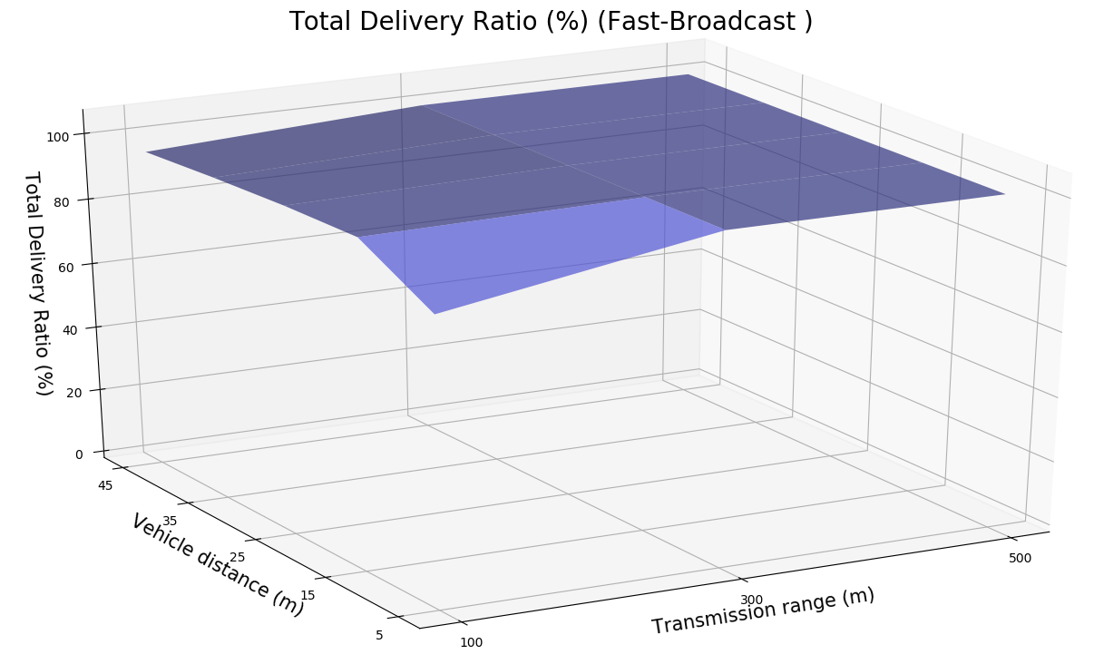
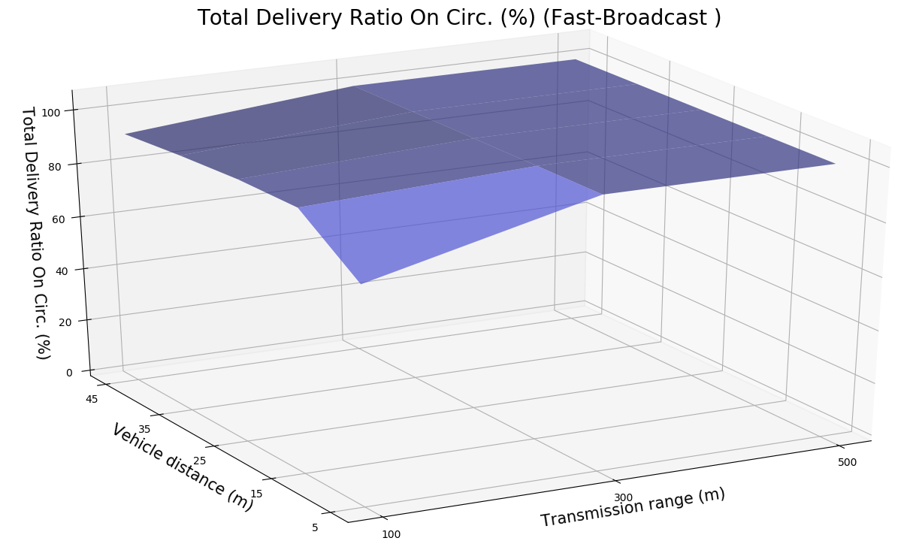
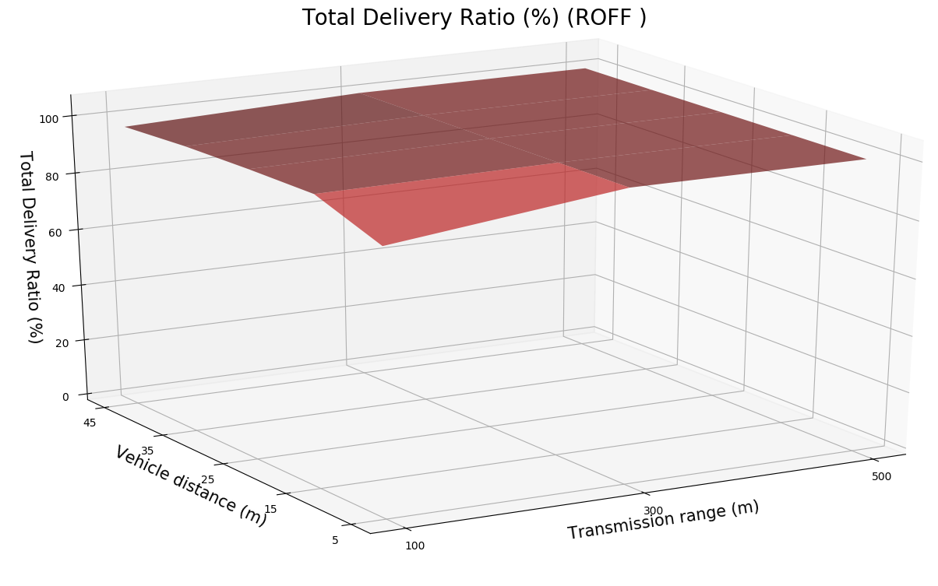
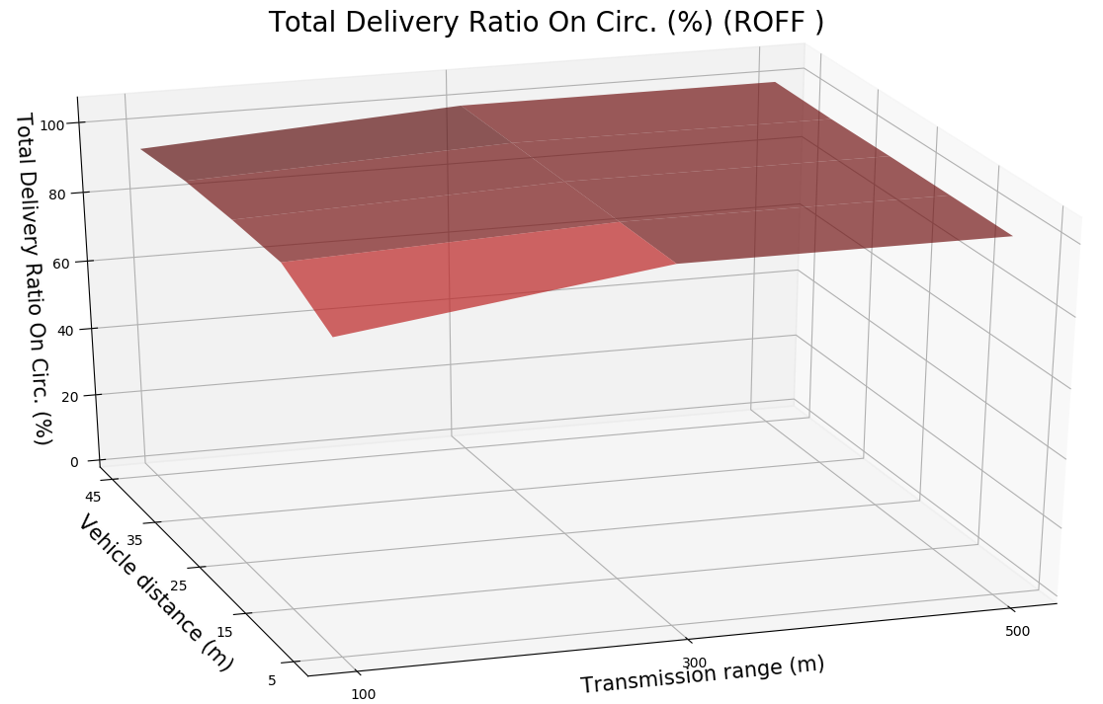
PRELIMINARY TESTS - DELIVERY RATIOS
5

Slide 12
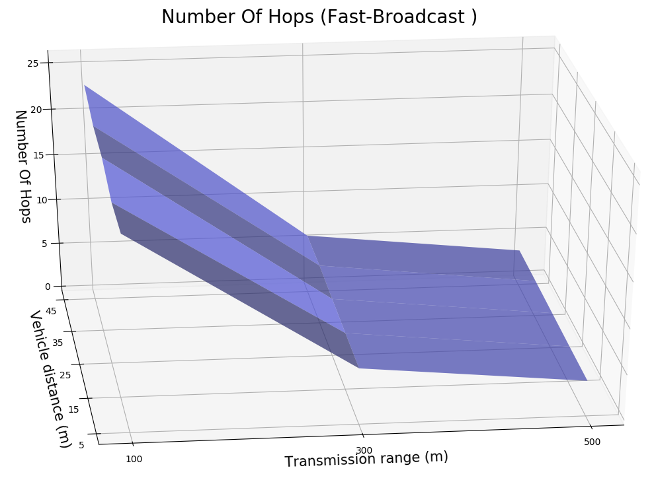
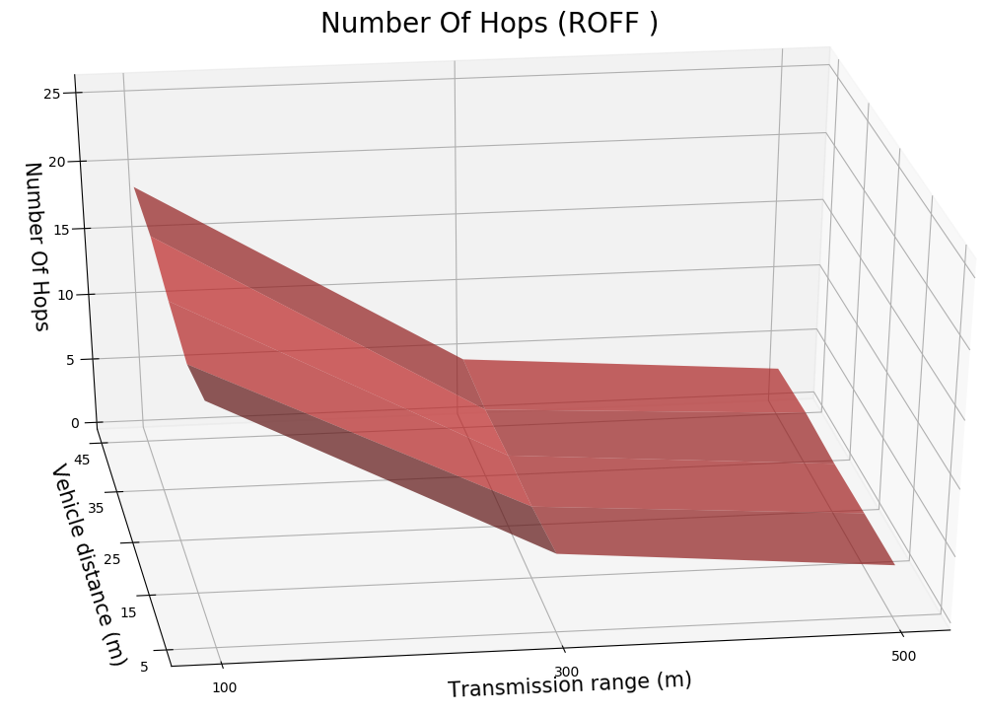
PRELIMINARY TESTS – NUMBER OF HOPS
5

Slide 13
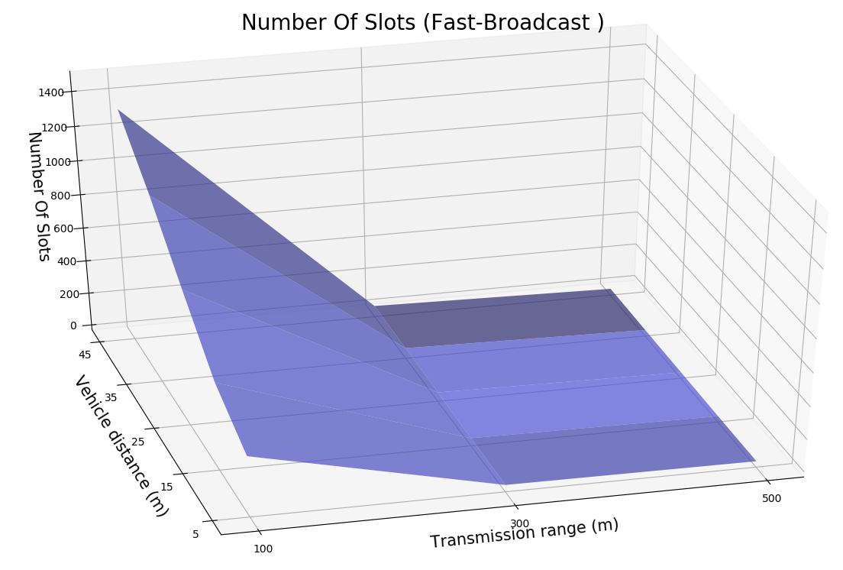
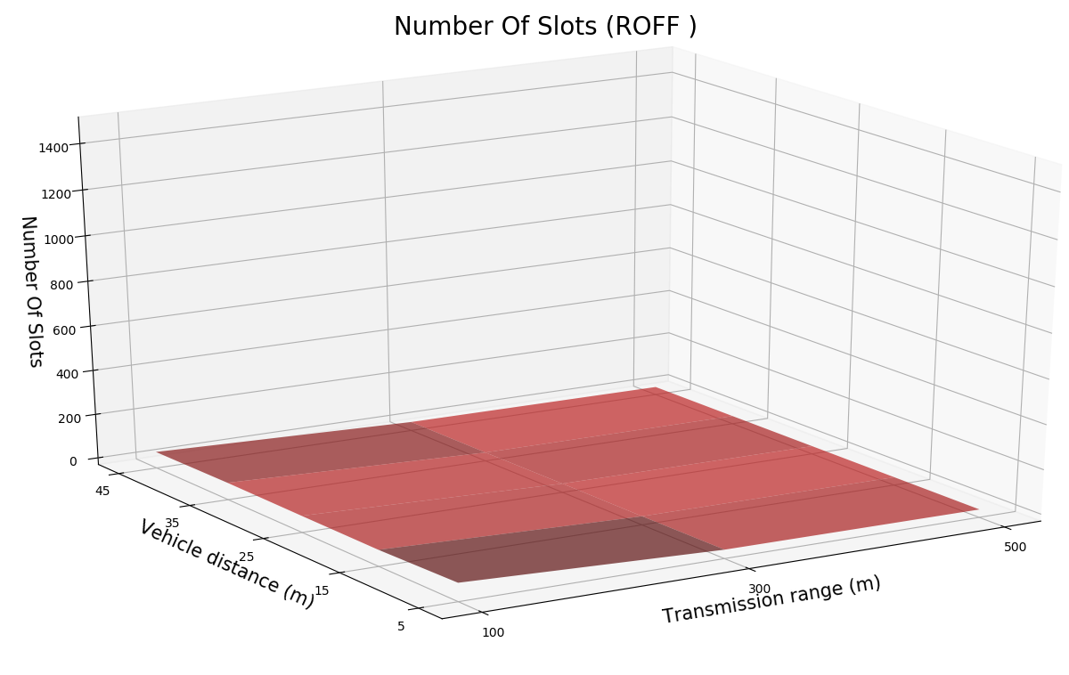
PRELIMINARY TESTS – NUMBER OF SLOTS
5

Slide 14
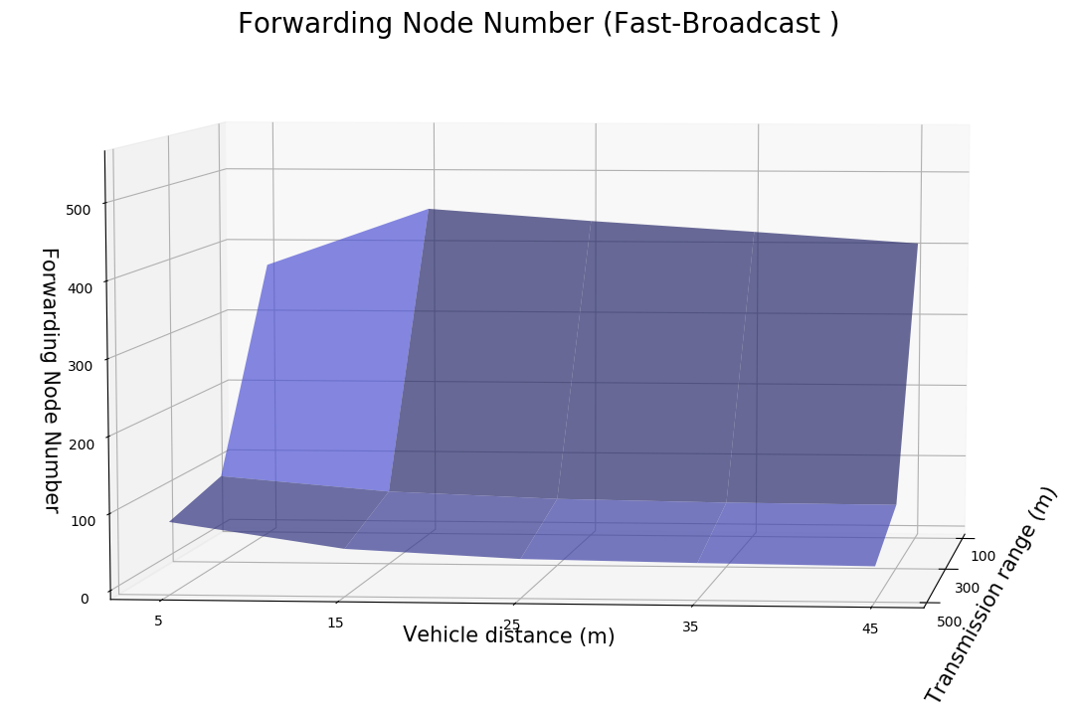
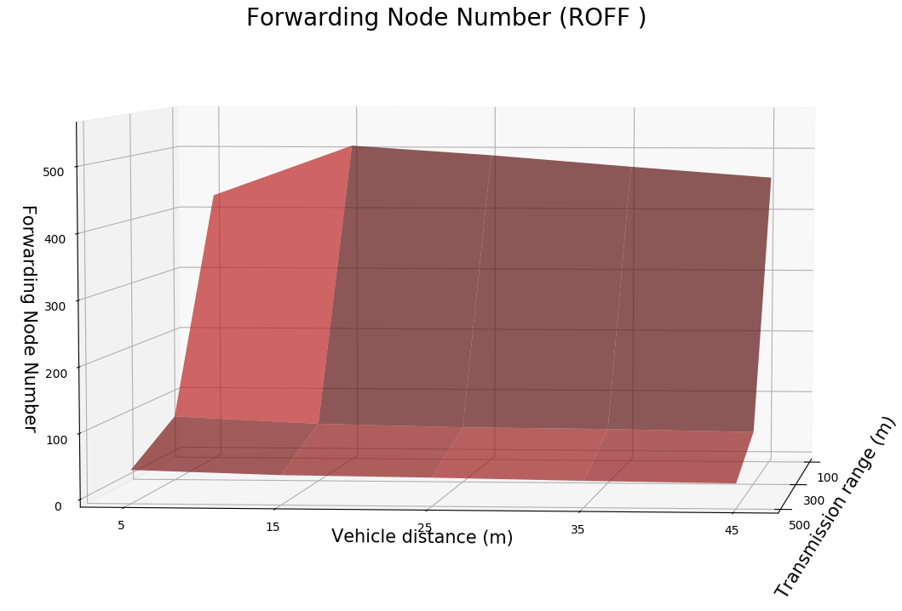
FORWARDING NODE NUMBER
5

Slide 15
PADUA URBAN SCENARIO
Scenario configuration
Scenario name | Padua
Latitude N [°] | 45.4171
Latitude S [°] | 45.3981
Longitude W [°] | 11.8654
Longitude E [°] | 11.8923
Circumference radius [m] | 1000
Distance between vehicles [m] | 25
Number of vehicles | 1775
Number of buildings | 6322
Number of simulations | 4500
Simulator configuration
Packet payload size | 100 byte
Frequency [GHz] | 2.4
Channel bandwidth [MHz] | 22
Transmission speed [Mbps] | 11
Transmission powers [dBm] | -7.0, 4.6, 13.4
Transmission ranges [m] | 100, 300, 500
Modulation | DSSS
Propagation loss model | ns3::TwoRayGround
Propagation delay model | ns3::ConstantSpeed
Shadowing model | ns3::ObstacleShadowing
5

Slide 16
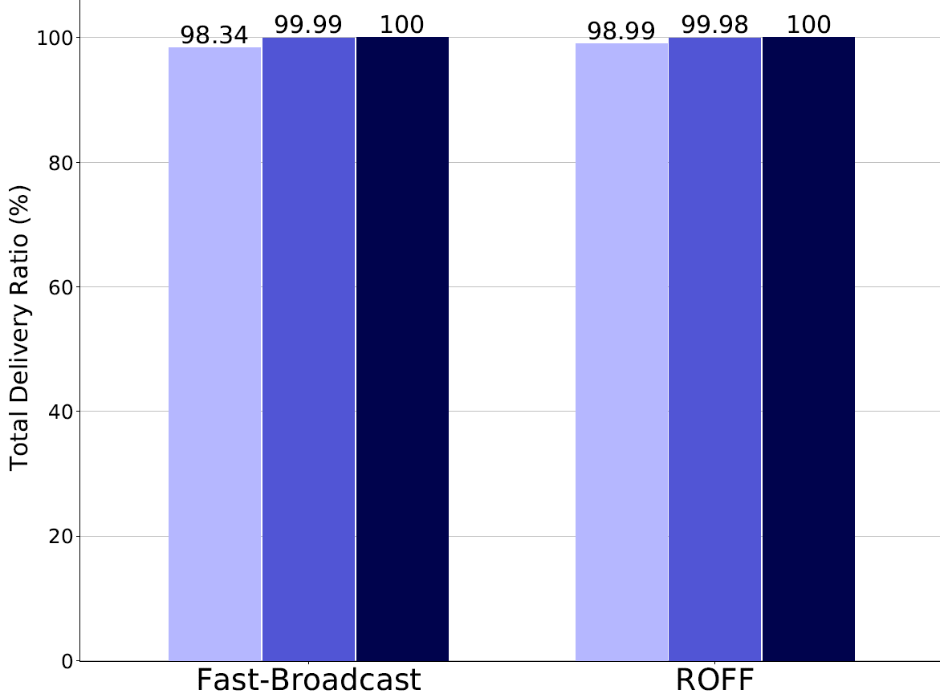
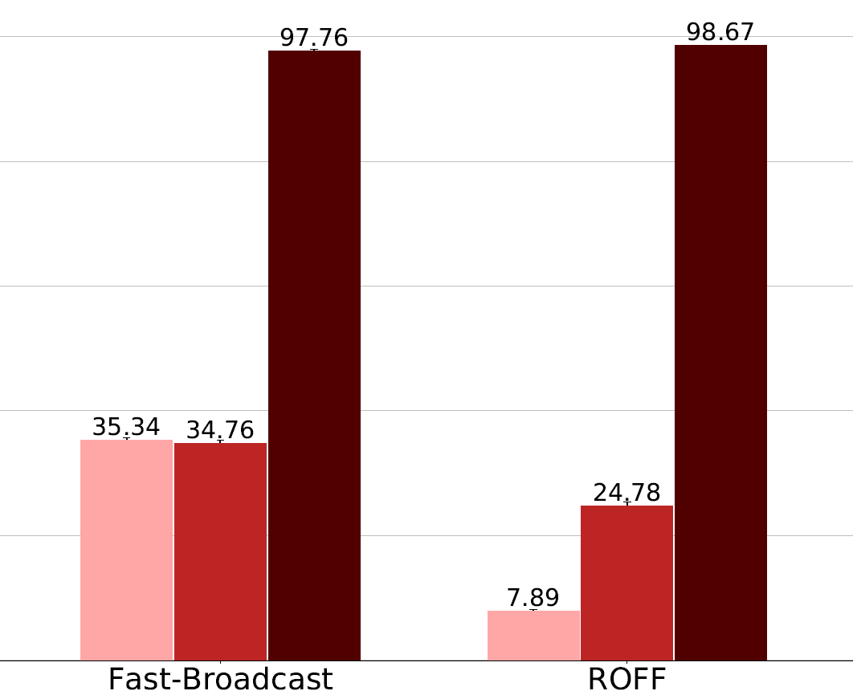






PADUA – TOTAL DELIVERY RATIO
Without buildings
With buildings
5

Slide 17
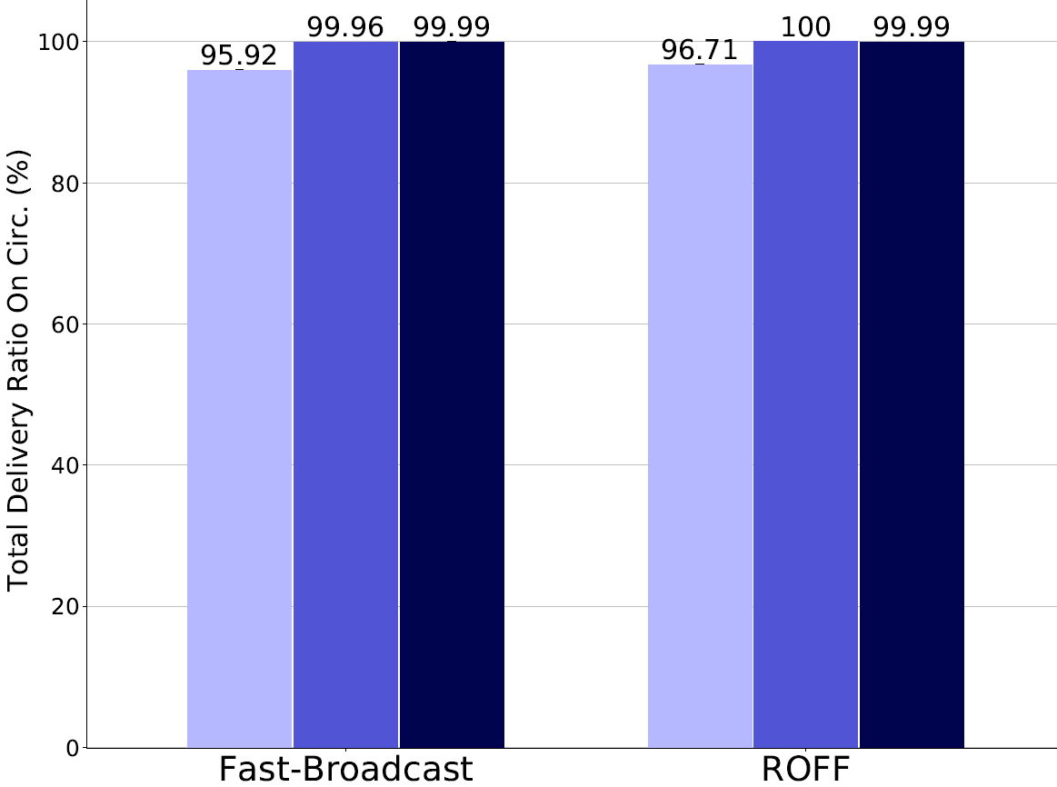
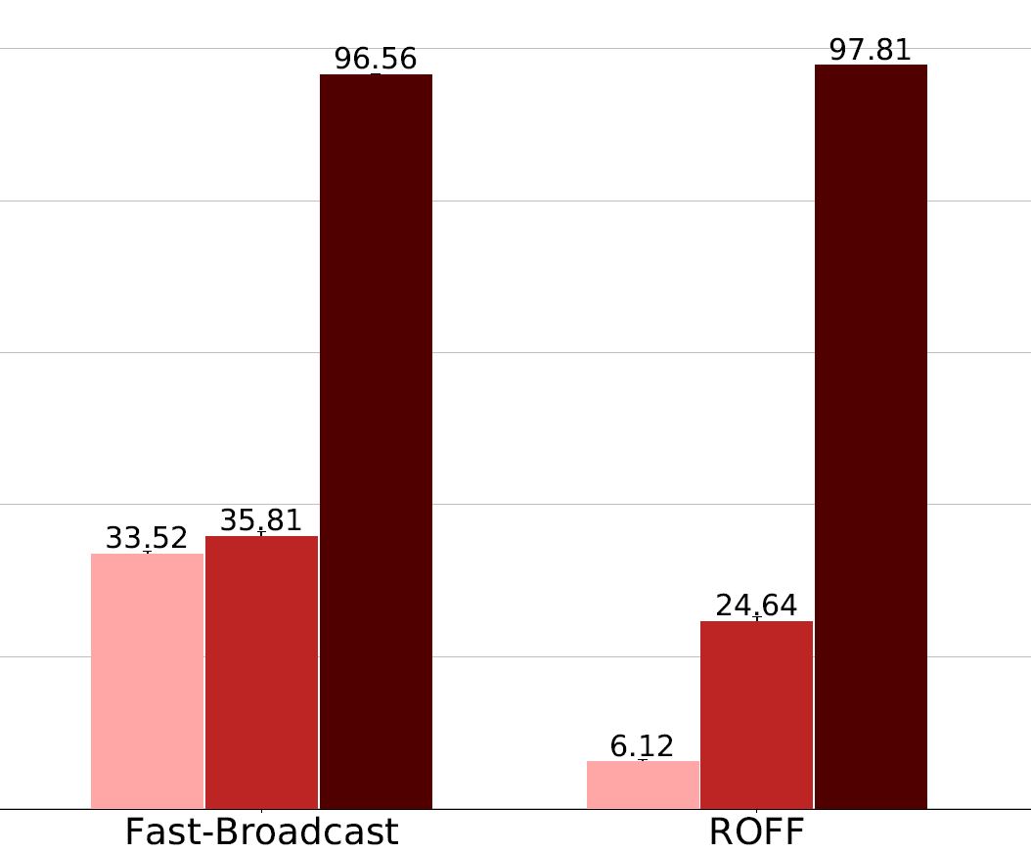
PADUA – TOTAL DELIVERY RATIO ON CIRC.
Without buildings
With buildings
5

Slide 18
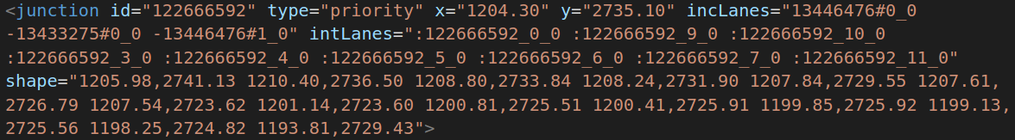
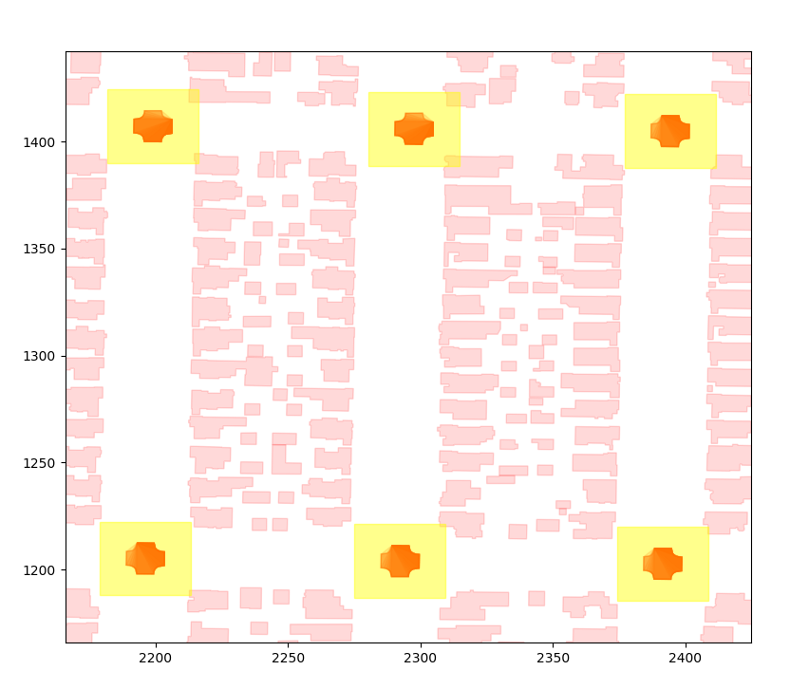
JUNCTION MODEL
Aim: exploit vehicles located within junctions to improve delivery ratios
Identification of junctions via OSM/SUMO tools
20x20m bounding box to extend the polygon
Vehicles within a junction participate in a second contention with other vehicles within the same junction
Extension applicable both to Fast-Broadcast and ROFF
SJ-Fast-Broadcast and SJ-ROFF
5

Slide 19
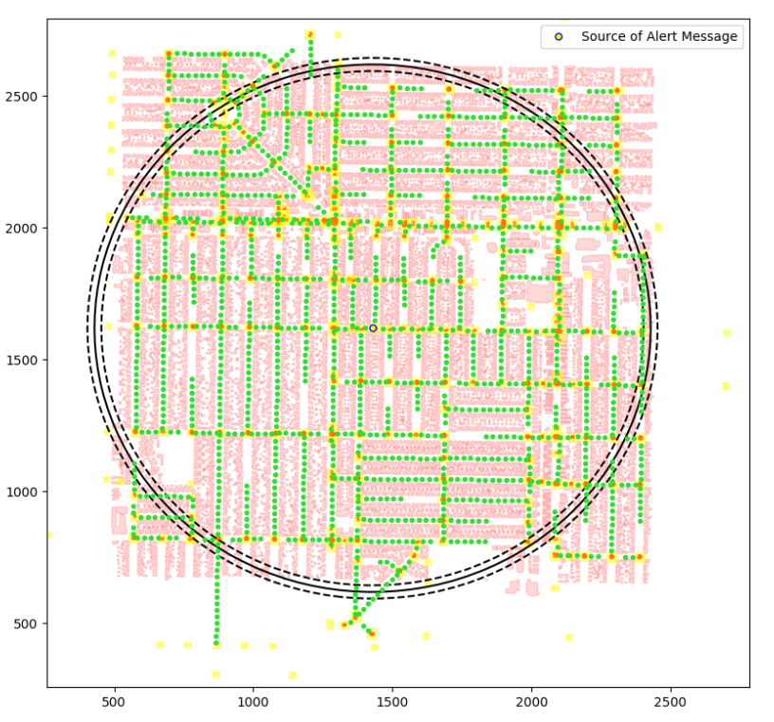
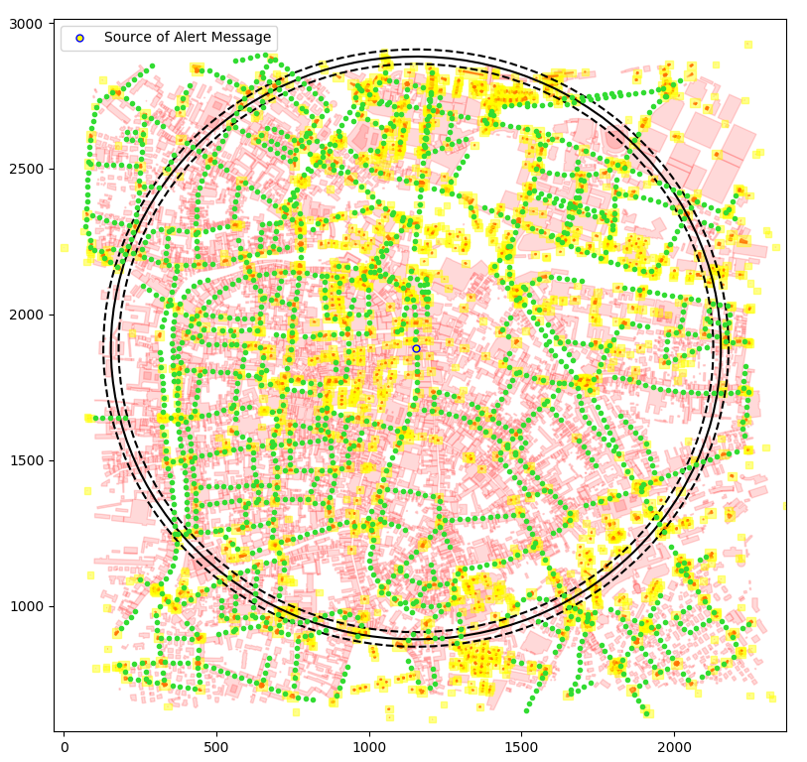
JUNCTION MODEL - SCENARIOS
Los Angeles
Padua
5

Slide 20
PADUA URBAN SCENARIO WITH JUNCTIONS
Scenario configuration
Scenario name | Padua
Latitude N [°] | 45.4171
Latitude S [°] | 45.3981
Longitude W [°] | 11.8654
Longitude E [°] | 11.8923
Circumference radius [m] | 1000
Distance between vehicles [m] | 25
Number of vehicles | 1775
Number of buildings | 6322
Number of junctions | 3231
Number of simulations | 4500
Simulator configuration
Packet payload size | 100 byte
Frequency [GHz] | 2.4
Channel bandwidth [MHz] | 22
Transmission speed [Mbps] | 11
Transmission powers [dBm] | -7.0, 4.6, 13.4
Transmission ranges [m] | 100, 300, 500
Modulation | DSSS
Propagation loss model | ns3::TwoRayGround
Propagation delay model | ns3::ConstantSpeed
Shadowing model | ns3::ObstacleShadowing
5

Slide 21
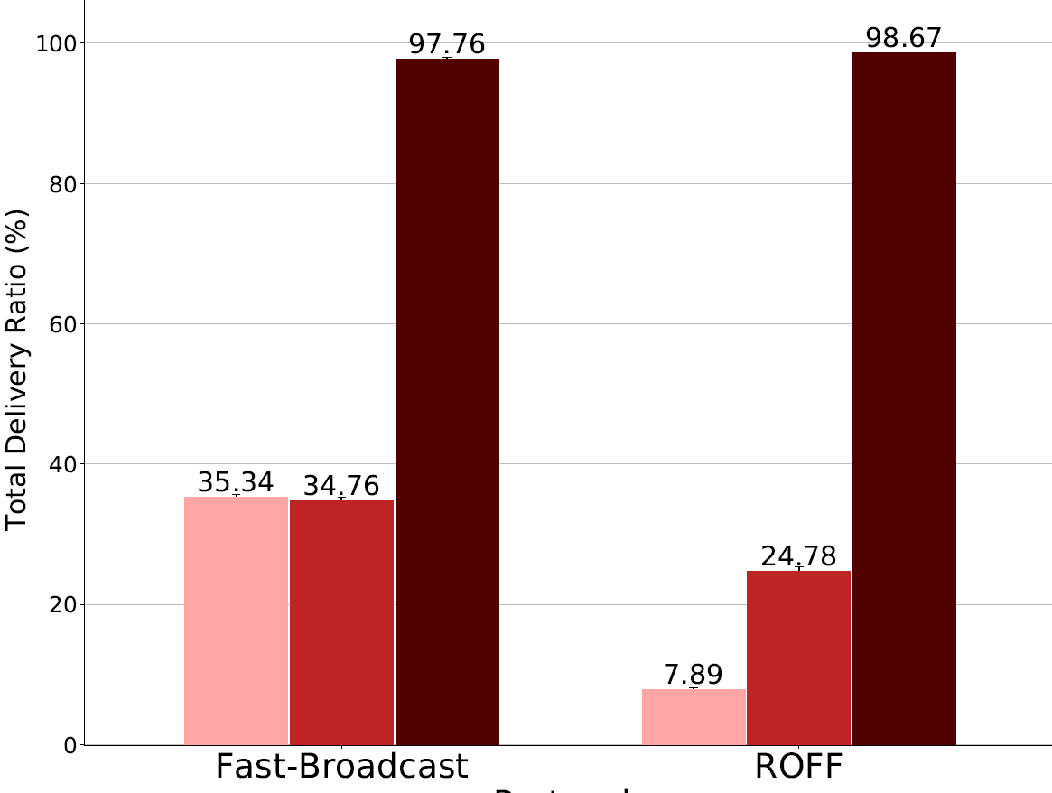
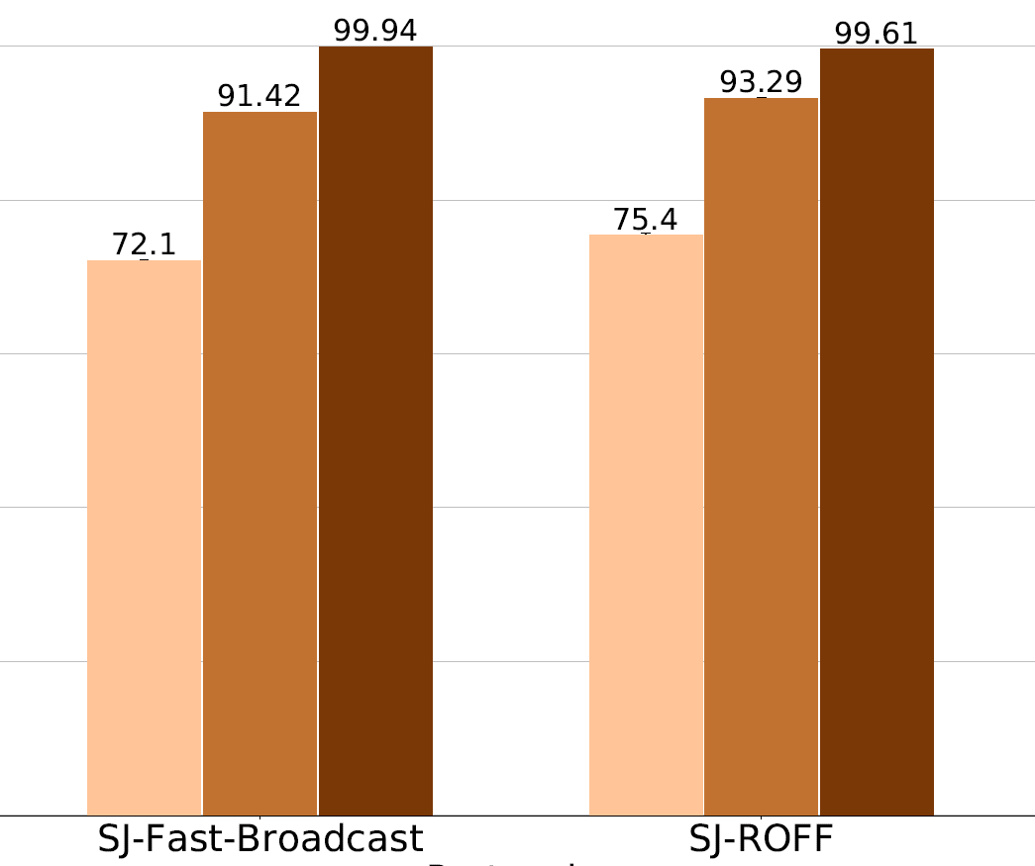



PADUA – TOTAL DELIVERY RATIO
With buildings, without junctions
With buildings, with junctions
5

Slide 22
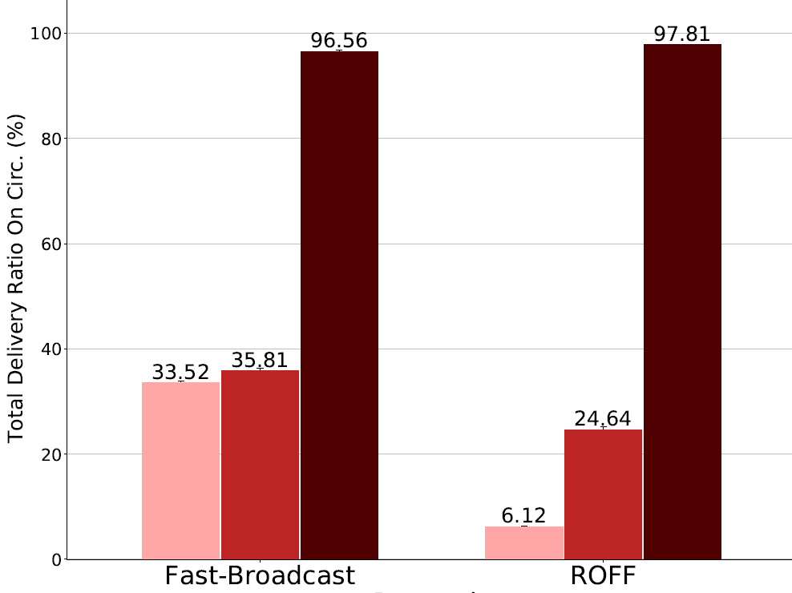
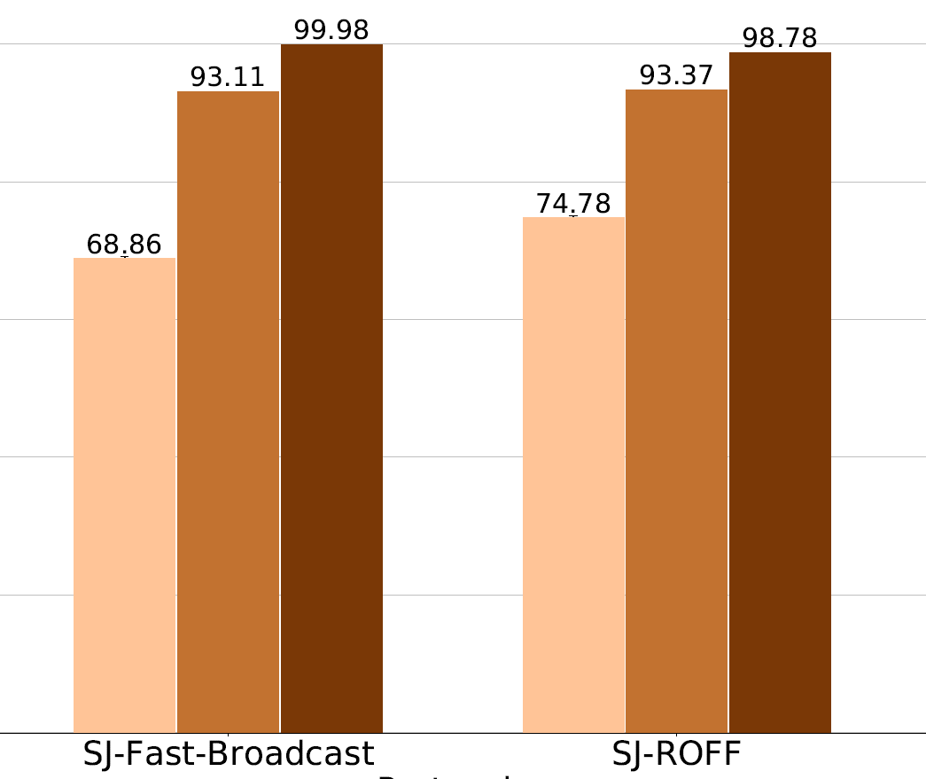
PADUA – TOTAL DELIVERY RATIO ON CIRC.
With buildings, without junctions
With buildings, with junctions
5

Slide 23
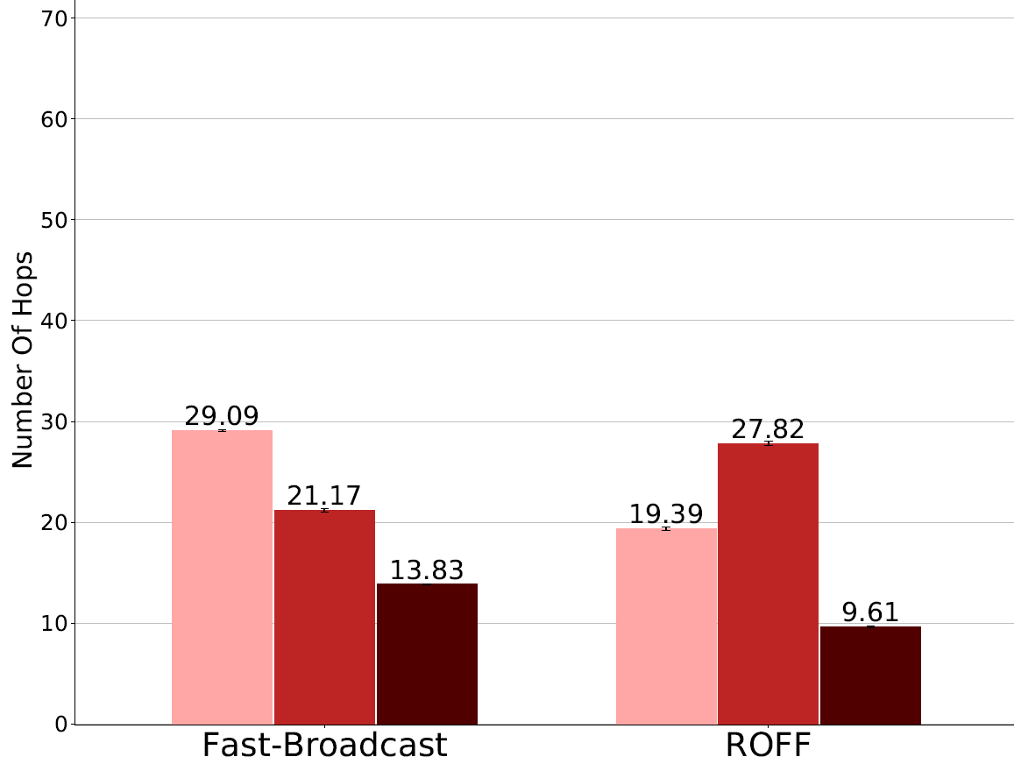
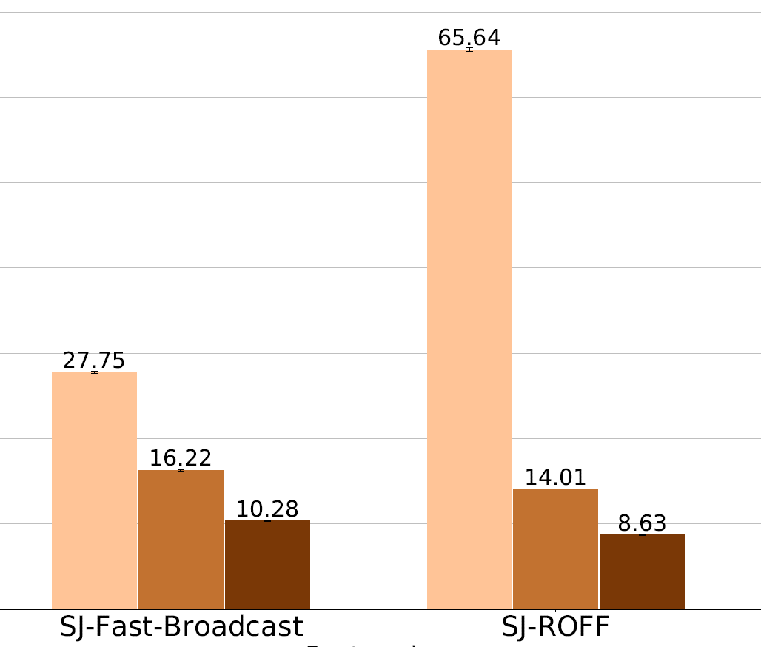
PADUA – NUMBER OF HOPS
With buildings, without junctions
With buildings, with junctions
5

Slide 24
PADUA – NUMBER OF HOPS
With buildings, without junctions
With buildings, with junctions
5

Slide 25
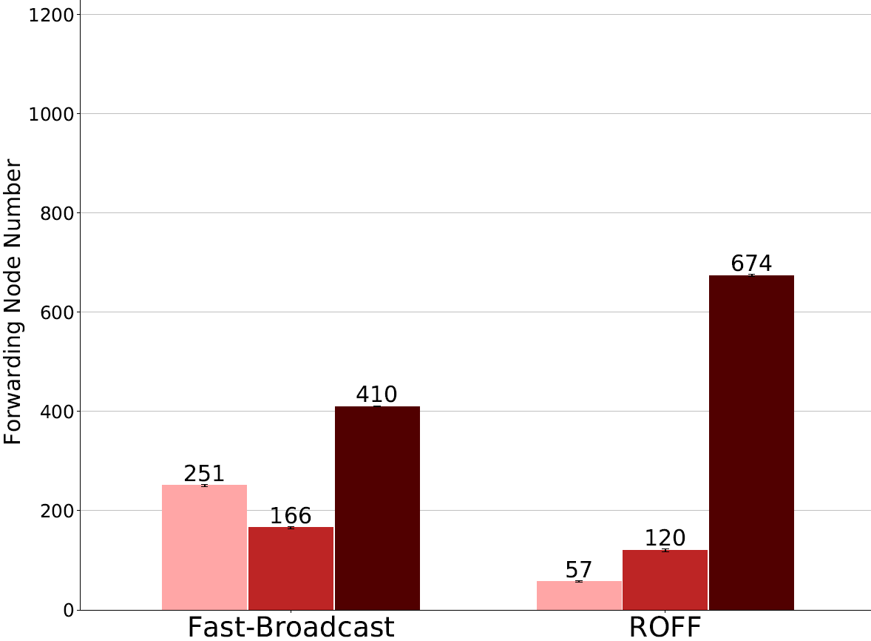
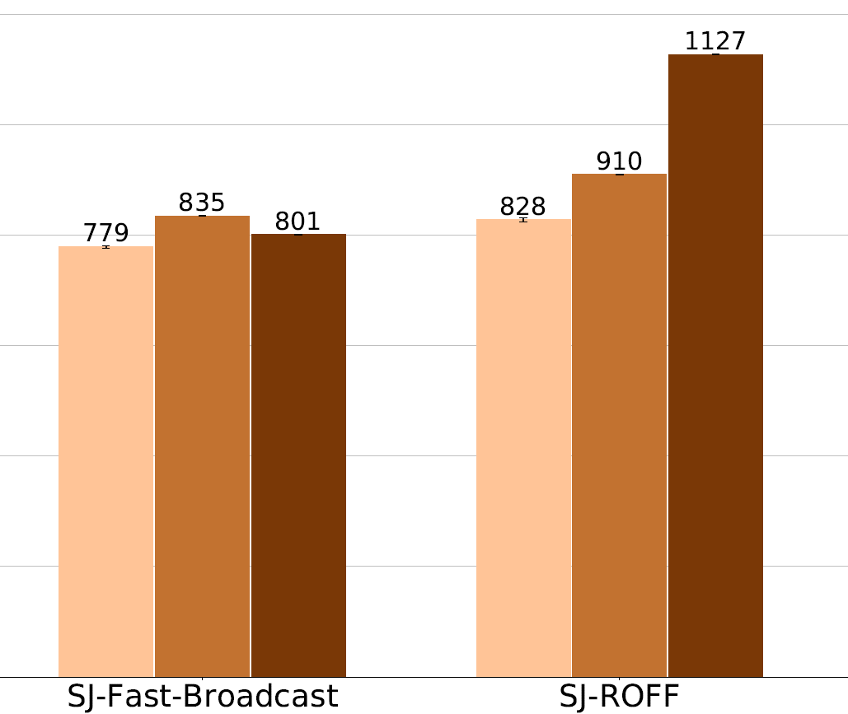
PADUA – FORWARDING NODE NUMBER
With buildings, without junctions
With buildings, with junctions
5

Slide 26
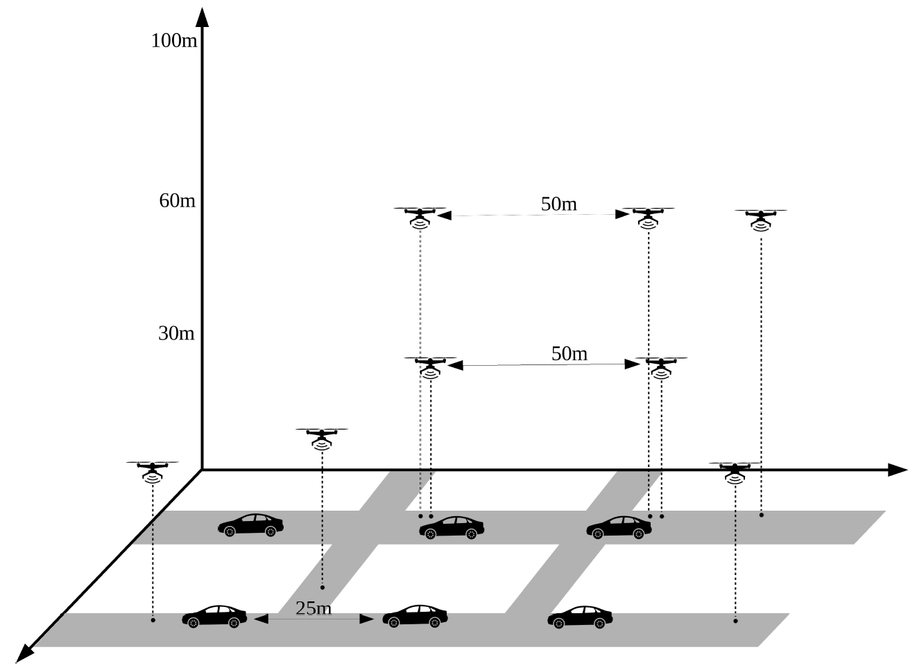
PADUA – FORWARDING NODE NUMBER
5

Slide 27
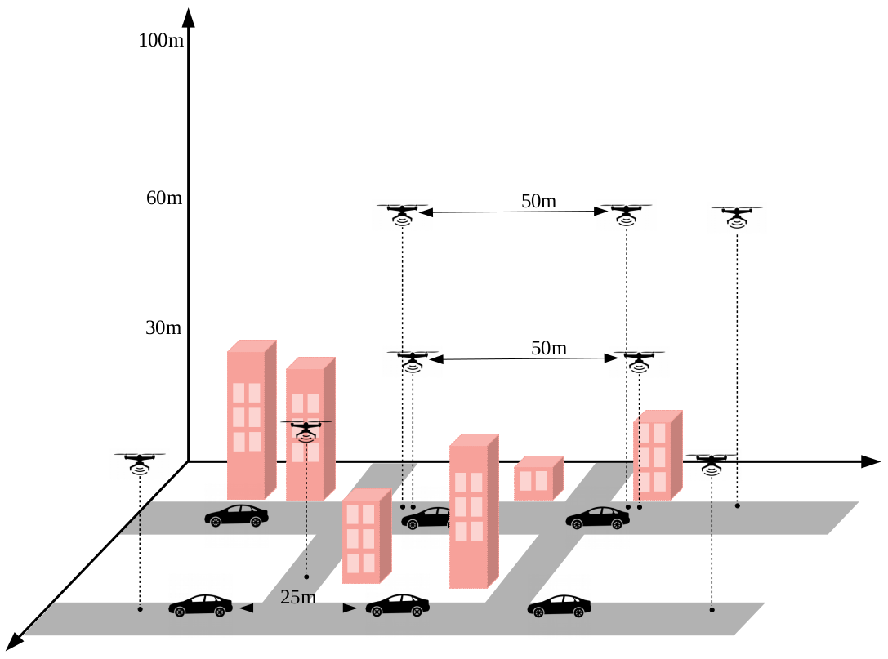
PADUA – FORWARDING NODE NUMBER
5

